Slide 1
Unit 8
Is there a post office near here?
Section B 3a-Self Check
七年级(下)

Slide 2
Review
post office library
hotel restaurant
bank supermarket
street pay phone
park house
garden market
Names of places

Slide 3
across
across from
next to
between …and…
介词(表示方位)
at
on
in
in front of
behind
under
near
through
left right

Slide 4
形容词及其反义词
new/old
early/late
big/small
tall
long
/short
quiet
free
/busy
bad/good
never/always
dirty/clean
heavy/thin (light)
hungry / full (饱的)
delicious/awful
open / closed(关着的)
cheap/expensive

Slide 5
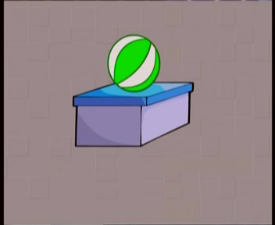
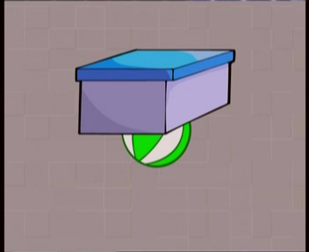
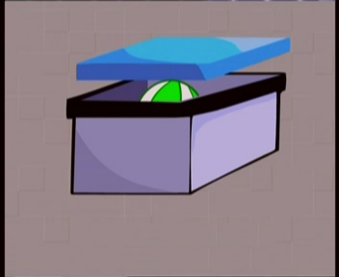
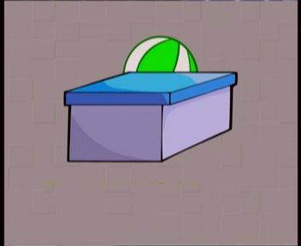
Where’s the ball?
Where’s=Where is
It’s on the box.
It’s under the box.
It’s in the box.
It’s behind the box.

Slide 6
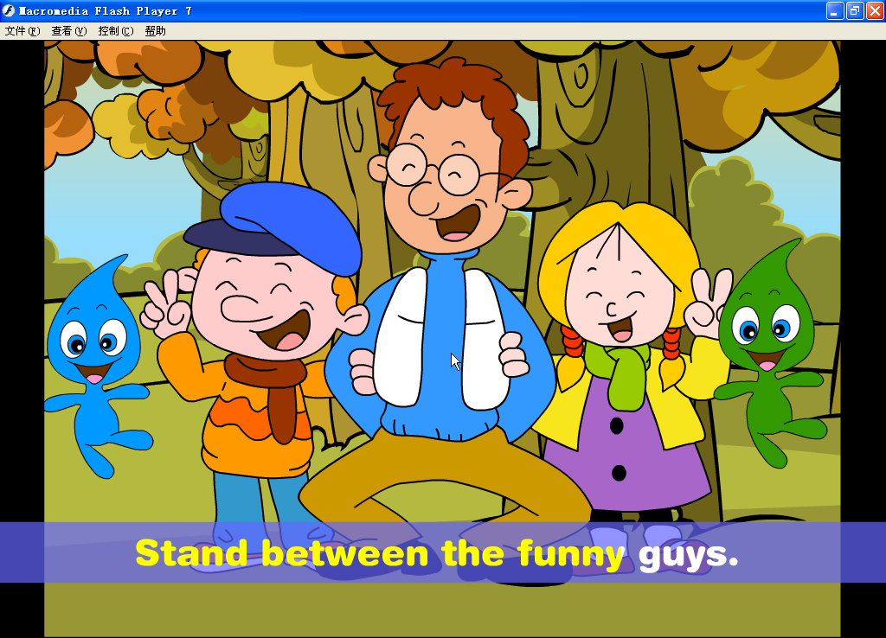
Jim
Lucy
He stands ________ Jim and Lucy.
between

Slide 7


go through the forest/park
through

Slide 8
go across the street
Center Street
across
across: 表示从一定范围的一边到另一边, 动作在物体
表面进行。
through: 从中间穿过, 动作在内部进行。

Slide 9
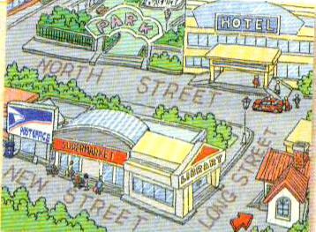
3a Look at the map of Cindy’s neighborhood and fill in the blanks.
My house is across from
a ______ on Long Street.
I usually go shopping at
a ______ near my house.
It is between a ______ and the ________. On weekends, I like to play in the ______. To get there, I go along Long Street and turn left on North Street. It is on the right, next to a ________.

Slide 10
Check the answers.
My house is across from a _______ on Long Street. I usually go shopping at a ____________ near my house. It is between a _______ and the _________. On weekends, I like to play in the _____. To get there, I go along Long Street and turn left on Long Street. It is on the right, next to a ______.
library
supermarket
library post office
park
hotel

Slide 11
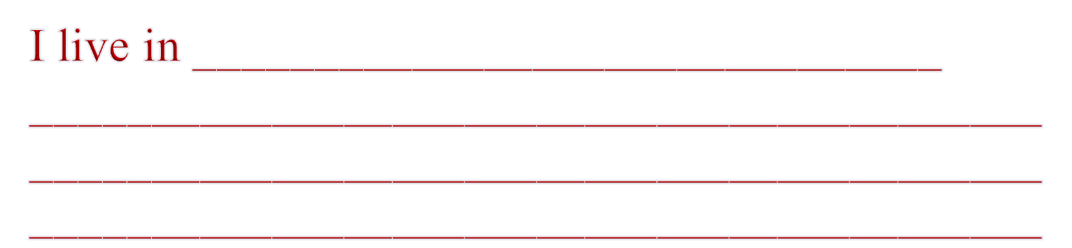
Writing
Draw a map of your neighborhood and write about it. These questions may help you.
3b
Where do you live?
What is your favorite place in your neighborhood? Why?
How do you get there from your home?

Slide 12
One possible version.
I live in ______________________________
______________________________________
__________________________________________________________________________________________________________________________________________________________________________________________________________________________________________________________________________
a noisy neighborhood. My house is between a library and a post office. There is a bank across from my house. My favorite place is the Children’s Palace because I can play sports and learn English there. To get there, I have to go along the Center Street, then turn left at the first crossing, then walk along North Street. The Children’s Palace is just on the right.

Slide 13
Self check
Complete the passage with the words in the box.
1
spend free climb enjoy
I am very busy on school days, but I have some ____ time on weekends. I like to spend time
with my grandparents on Sundays. My grandma makes the foods I like. And I _____ playing Chinese chess with my grandpa. He’s very good at it! We also like to sit and talk. We sometimes watch the neighbor’s cats ________ the trees.
It’s relaxing to _____ weekends like this. I love my grandparents!
free
enjoy
climbing
spend

Slide 14
Write five sentences about your school using there is/ are.
2
_______________________________.
_______________________________.
_______________________________.
_______________________________.
_______________________________.

Slide 15
提示：注意 there be 句型一定要注意 be 动词(is，are)与其后面的主语一致。特别应注意，如果有两个或两个以上的主语时，应与第一个保持一致。句型：There is /are + … + (介词短语) …

Slide 16
___________________________________.
___________________________________.
___________________________________.
__________________________________________.
__________________________________________.
There is a zoo on Bridge Street
There is a supermarket next to the bank
There is a bus stop behind the hospital
There are two pay phones in front of the park
There is a library across from the clothes shop

Slide 17
Imagine you are one of the people in the picture on Page 46. A person asks you how to get to the supermarket or library. Write a conversation.
3

Slide 18
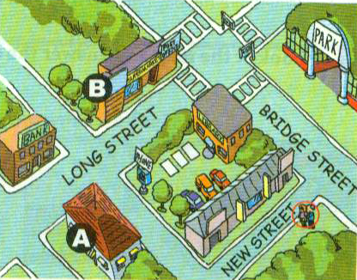

Slide 19
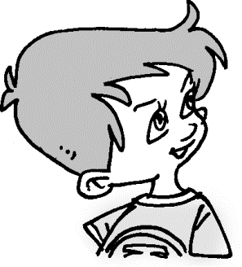
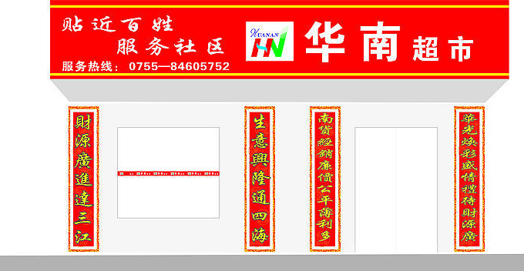
A: Excuse me. Is there a supermarket near here?
You: Walk along New Street. Turn left at the first crossing. Walk along Bridge Street and turn left when you see the library. The supermarket is between the post office and the bank.
A: Thank you very much.
You: You’re welcome.

Slide 20
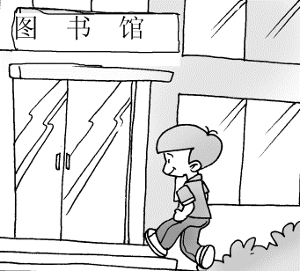
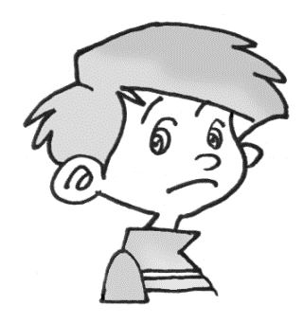
A: Excuse me. Is there a library near here?
You: Walk along Bridge Street. Turn left at the first crossing. Then you can see the library on your left. It’s across from a park.
A: Thank you very much.
You: You’re welcome.

Slide 21
1. Fill in the blanks and role play the conversation.
Practice
A: Excuse me. Is _____ a bank ____ here?
B: Yes. There is one ___ Tall Tree Street.
A: How can I ____ there?
B: Go _____ Center Street. _____ right at the first crossing. Then walk along Tall Tree Street. The bank is ___ you right. It’s ________ the post office and the restaurant.
A: Thank you very much.
B: You’re ________.
there near
on
get
along Turn
on
between
welcome

Slide 22
2. Read the conversation and fill in the blanks.
place
A: Hi, Alice. What’s your favorite _____?
B: Well, I like the zoo best.
A: Is _____ a zoo in your _____________?
B: Yes, there is.
A: Is it far _____ your home?
B: No, It’s about two kilometers from my home.
A: Really? ____ can you ____ there?
B: Oh. Go _____ Lake Road and turn left ___ the first crossing. It’s on the right on Sixth Road.
A: Great. Let’s go to the zoo right now.
there
neighborhood
from
How get
along
at

Slide 23
3. Fill in the blanks.
1. If you want to borrow a book, you will go to
the ________.
2. If you want to have fun, you will go to the
_____________.
3. If you want to buy some food or household
goods, you will go to the _________________.
4. If you want to have a meal, you will go to the
____________.
5. If you want to mail a letter, you will go to the
__________.
library
park/garden
supermarket/market
restaurant
post office

Slide 24
4.词汇运用。
fifth
1.The supermarket is on the ______(five)
Avenue.
2.There are two __________(library) in our
school.
3.Ben has an ___________(interest) book.
4.Let’s read from the ___________(begin) of
this book.
5.This isn’t my shirt. It’s _______(you).
libraries
interesting
beginning
yours

Slide 25
5.单项选择。
Please look around. What can you see
_____your right？
A. in B. on C. at
2. --Excuse me. _____ to get to the airport?
--Take a taxi.
A. What B. When C. How
3. Let Jane _____ the art club. She likes
drawing.
A. joining B. join C. joins
B
C
B

Slide 26
A
4. _____ there a bank along the street?
A. Is B. Are C. Am
5. The pay phone is ____ the post office and
the library.
A. in B. between C. near
6. Martin is sitting next _____ me.
A. to B. on C. around
7. -- _____ there orange juice in the fridge?
-- I don’t know.
A. Am B. Are C. Is
B
A
C

Slide 27
8.The park is across ____ the supermarket.
A. in B. on C. from
9.We can buy some _____ in the food market.
A. bread B. baseballs C. clothes
10. My uncle will _____ Beijing next Sunday.
A. get B. arrive in C. arrive at
C
A
B

Slide 28
6.句型转换。
1.There are some cars on the street.
（变为一般疑问句）
_____ there ____ cars on the street?
2.The restaurant is across from the bank.
（对划线部分提问）
_______ is the restaurant?
3.The English club is next to the library.
（变为同义句）
The English club is ________ the library.
Are
any
Where
beside

Slide 29
4. Excuse me. How can I get to the post
office? （变为同义句）
Excuse me. _____ _____ get the post
office?
5. Turn right and go straight along the
Bank Street. （变为同义句）
Turn right and go straight ______ the
Bank Street.
How to
down

Slide 30
Homework
Writing: 根据下图写一段话。
CEBTRAL ST
Library
Restaurant
Post Office
RENMIN ST
Bank
Supermarket
Park

Slide 31
Thank You!

